Slide 1
Object Oriented Programming (Introduction to Programming) Manuel Mazzara
Organizational Information

Slide 2
Office Hours
Thursday 6pm-7pm
In any case you can get an appointment dropping me an email with a reasonable notice (24 hours, possibly 48)
Every TA has office hours too, please jut ask
Do not be shy to use all the resources you have!

Slide 3
Survey
http://goo.gl/forms/HMw586zG9q
It helps us to understand your level of acquitance with computers and computer science
We will tune lectures and labs accordingly
Next year a different division of groups may be implemented
Your TA will repeat and explain this later today

Slide 4
Poll
It will be released later
This is to understand how we can provide a better service to you
Problems can be of differnet Kind

Slide 5
Problems?
Room, Schedule, transport
Workload
Pedagogy
Organization
Motivation
Can you see the reasons and the applications behind the theory?
Unmanageable workload?
Barrier between teachers and students?

Slide 6
Our Approach
We are trying to teach programming to a class with very etherogenous skills and background
We are trying to give something new to everyone
Our approach is different from many others to teach programming
We hope that people with more advanced skills can find something new too

Slide 7
We teach principles and concepts
… not technology!
Do not be afraid of the specific technologies we take as examples
You will learn more and more languages and technologies in your life
Focus on the concepts and this will stay with you for all your professional life!

Slide 8
Object Oriented Programming (Introduction to Programming) Manuel Mazzara
Lecture 4a: Class Invariants

Slide 9
What we have seen last week
Classes
The notion of interface
GUI vs API
Contracts
Preconditions
Postconditions
Class invariants

Slide 10
Reading assignments
Chapter 4 of “Touch of Class, Learning to Program Well with Objects and Contracts”

Slide 11
Class invariants
Preconditions and postconditions are logical properties associated with a particular feature
Class invariants are properties that all objects of a certain class must obey to
Class invariants are part of the class semantics
…
Invariant
class DATE
valid_day: 1 <= day and day <= 31
valid_hour: 0 <= hour and hour <= 23

Slide 12
Class invariant principle
A class invariant must hold as soon as an object is created, then before and after the execution of any of the class features available to its clients.
A class that fails to ensure its invariants is buggy software.

Slide 13
What are class invariants in practice?
Boolean expressions checked every time a supplier’s status is observable by clients:
As soon as an object is created
Before and after a feature is available to clients
The simplest possible class invariant (and the default) is the expression True
This would mean that there are no consistency requirements

Slide 14
Compound class invariants
Expressions can also be linked together using logical connectives like and, or, not, =, and implies
Writing two expressions on two consecutive lines without connectives is considered as an implicit and
It is also possible to invoke a separate Boolean function containing complex computations

Slide 15
When things go bad...
An exception is raised if an invariant check fails:
Immediately after an object is created
Before or after a client invokes a routine
The error should be relatively easy to fix, as we know where in the code it occurred
The label on the class invariant can be useful

Slide 16
When breaking class invariant is OK
A class invariant is allowed to be not satisfied in the following cases:
Before the invocation of a creation feature
In the body of any routine
Anything can happen between states observable by clients
Notes:
The meaning of class invariants • They are intended for scenarios that should never happen, if supplier routines do their job • When a class invariant fails, it points at errors in the implementation or in the class invariant • They contribute to a safety net all around your software, so that all routines are checked for (partial) correctness • They can be disabled at runtime for efficiency in production code

Slide 17
Runtime contract checks
There is a performance penalty when contracts are activated at runtime
Contract checks can be partially or totally disabled (e.g. keep preconditions only)
Hint: disable contract checks only after an application has been properly tested
They can always be enabled again if some error pops out and you hope to know more about it

Slide 18
Applications of Design by Contract
More efficient debugging
programs fail earlier => cheaper to fix
it is easier to reason about errors because they are better localized
Better documentation
contracts are part of the class interface
clients know how to invoke a feature correctly and what to expect in return
part of the documentation is executable

Slide 19
Automatic Testing
Automatic testing
tests can be generated automatically from contracted code
preconditions filter out uninteresting/wrong inputs
postconditions are oracles, providing a pass/fail response

Slide 20
(In)complete and (un)sound preconditions
If the intended precondition for feature f is:
f (x: INTEGER) require x_valid: x > 1
w: x > 0 is an over-approximation (too weak), accepts an incorrect value, together with all the correct ones (unsound and complete)
z: x > 2 is an under-approximation (too strong), accepts all correct values, but not all the possible correct values (sound and incomplete)

Slide 21
(In)complete and (un)sound postconditions
Soundness and completeness for postconditions are dual with respect to preconditions
If the intended postcondition for feature g is:
g … ensure y_correct: y > 1, with y: INTEGER
w: y > 0 is an over-approximation (too weak), guarantees all the correct values, but the guaranteed values are not all correct (sound and incomplete)
z: y > 2 is an under-approximation (too strong), does not guarantee all the correct values, but the ones it does guarantee are correct (unsound and complete)

Slide 22
Limitations of contracts
Writing contracts that are both sound and complete is difficult, and sometimes impossible
Preconditions are easier to handle because they refer to one object state (the current object)
Postconditions are trickier because they refer to two possible object states (before and after the feature execution)

Slide 23


Is Design by Contract a silver bullet?
No, but it may help to produce better software
In the end contracts are written by humans
Humans can write wrong, or weak contracts
Think about what happens if you always write True in all your contract clauses

Slide 24
Object Oriented Programming (Introduction to Programming) Manuel Mazzara
Lecture 4b: Abstraction

Slide 25
Topics for today (and possibly next week)
Abstraction, especially functional abstraction
The notion of routine
The final word on features: all feature categories
The Uniform Access principle
Abstraction and client privileges
Information hiding
Deferred Classes

Slide 26
Abstraction
“The essence of abstractions is preserving information that is relevant in a given context, and forgetting information that is irrelevant in that context.”
Guttag, John V.
“Introduction to Computation and Programming Using Python” - Cambridge, Massachusetts: The MIT Press.
Concepts are independent from languages

Slide 27
Routine: algorithm abstraction
To abstract is to capture the essence of a concept, ignoring details & specifics
Implies:
Removing some information
Giving a name to the result of the abstraction
In Object Oriented Programming:
Data abstraction: class
Algorithm (operational) abstraction: routine
A routine is also known as a method
And also as a subprogram and as a subroutine

Slide 28
A routine is one of the two kinds of feature...
... the other is attribute

Slide 29
A routine
r (arg : TYPE ; ...)
-- Header comment.
require
Precondition (boolean expression)
do
Body (instructions)
ensure
Postcondition (boolean expression)
end

Slide 30
Two kinds of routine
Procedure: doesn’t return a result
Yields a command
Calls are instructions
Function: returns a result f (arg : TYPE; ...): RESULT_TYPE
... (The rest as before) ...
Yields a query
Calls are expressions
Control flow moves from an execution context to another

Slide 31
Features: the full story
A class is characterized by its features
Each feature is an operation on the corresponding objects:
query
or command

Slide 32
Pay attention now!
We said there are two kind of features for a class
Routine
Attribute
And at the same time there are two kinds of routines
Procedure
Function
How all these relate to each other?

Slide 33
Features: the full story
Client view (specification)
Internal view (implementation)
Command
Procedure
No result
Routine
Computation
Feature
Feature
Feature
Feature
Memory
Returns result
Function
Computation
Query
Memory
Attribute

Slide 34
The Uniform Access principle
It doesn‘t matter to the client whether you look up or compute

Slide 35
Uniform Access: an example
balance = list_of_deposits.total – list_of_withdrawals.total
list_of_deposits
200
300
500
1000
(A1)
list_of_withdrawals
800
100
100
balance 1000
list_of_deposits
200
300
500
1000
(A2)
list_of_withdrawals
800
100
100
A call such as your_account.balance
could use an attribute or a function

Slide 36
The Uniform Access principle
It doesn‘t matter to the client whether you look up or compute

Slide 37
The Uniform Access principle
Expressed more technically:
Features should be accessible to clients the same way
whether implemented by storage or by computation

Slide 38

An object has an interface
set
x
y
set_x
set_y

Slide 39
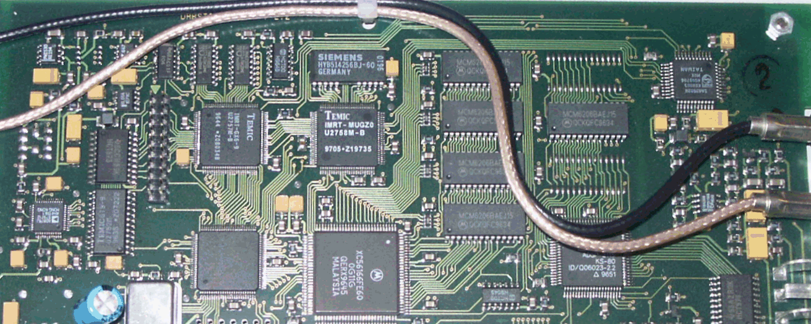
An object has an implementation
set
first
x
y
set_x
set_y
count

Slide 40
Information hiding
set
x
y
set_x
set_y

Slide 41
Abstraction and client privileges
If class A has an attribute x, what may a client class C
do with for a1 of type A ?
C
A
a1
a1 : A
x
a1.x
a1
x
(C )
(A)
Read access if attribute is exported
a1.x is an expression!
An assignment a1.x := v would be syntactically illegal!
(It would assign to an expression, like a + b := v )

Slide 42
Applying abstraction principles
To provide clients with writing privileges: define a setter procedure, such as
set_temperature (u : REAL) -- Set temperature value to u. do temperature := u ensure temperature_set: temperature = u end
Clients will use calls such as
x.set_temperature (21.5)

Slide 43
Taking full advantage of a setter command
set_temperature (u : REAL) -- Set temperature value to u.
require
not_under_minimum: u >= -273
not_above_maximum: u <= 2000
do temperature := u update_database
ensure temperature_set: temperature = u
end

Slide 44
Abstraction and client privileges
If class A has an attribute x, what may a client class C
do with for a1 of type A ?
C
A
a1
a1 : A
x
a1.x
a1
x
(C )
(A)
Read access if attribute is exported
a1.x is an expression!
An assignment a1.x := v would be syntactically illegal!
(It would assign to an expression, like a + b := v )

Slide 45
Exporting (making public) an attribute
In Eiffel, exporting an attribute means exporting it read-only
From the outside, it is not shown as an attribute, just as a query: it could be a function
In C++, Java & C#, if you make public an attribute x, it is available for both read and write:
v := a1.x
a1.x := v

Slide 46
Features: the full story
Client view (specification)
Internal view (implementation)
Command
Procedure
No result
Routine
Computation
Feature
Feature
Feature
Feature
Memory
Returns result
Function
Computation
Query
Memory
Attribute

Slide 47
Getter functions
In C++, Java & C#, the standard technique, if private_x is secret, is to export an associated getter function:
x : T
do
Result := private_x
end
Eiffel needs no getter functions: just export the attribute
This is safe: the attribute is exported
Only for reading
Without the information that it is an attribute: it could be a function (Uniform Access principle)

Slide 48
The role of deferred classes
Express abstract concepts independently of implementation
Express common elements of various implementations
Terminology: Effective = non-deferred
(i.e. fully implemented)

Slide 49
Applications of deferred classes
Abstraction
Taxonomy
Capturing common behaviors
High-level modeling, analysis and design
…

Slide 50
Deferred classes
A class is deferred if it has at least one deferred feature
If so:
It must be declared as deferred class…
It cannot be instantiated
with x: LIST,
create x is not possible
(but only e.g. create y.make (…) where y is of type ARRAYED_LIST)
LIST*
LINKED_ LIST ⁺
ARRAYED_ LIST ⁺

Slide 51
About reuse
A powerful form of reuse:
The reusable element defines a general scheme
Specific cases fill in the holes in that scheme
“Programs with holes”

Slide 52
Abstract modeling
deferred class VEHICLE feature dues_paid (year: INTEGER): BOOLEAN is
do... end
valid_plate (year: INTEGER): BOOLEAN is
do... end
register (year: INTEGER) is
-- Register vehicle for year.
require
dues_paid (year)
deferred
ensure
valid_plate (year)
end ... Other features, deferred or effective...
end -- class VEHICLE

Slide 53
What we have seen
Routines: features that actually compute something
Procedures: do something, do not return anything
Functions: compute and return a result
Uniform Access principle: the client does not need to know whether a result is looked up or computed
Deferred classes: a mechanism for expressing concepts and their abstract properties independently of any implementation concern

Slide 54
Topics for today
Abstraction, especially functional abstraction
The notion of routine
The final word on features: all feature categories
The Uniform Access principle
Abstraction and client privileges
Information hiding
Deferred Classes

